Slide 1

Bayes’ Nets
Read AIMA Chapter 13 “Probabilistic Reasoning” (Sections 13.1, 13.2 and 13.3)
Slides courtesy of Dan Klein and Pieter Abbeel – University of California, Berkeley
[These slides were created by Dan Klein and Pieter Abbeel for CS188 Intro to AI at UC Berkeley. All CS188 materials are available at http://ai.berkeley.edu.]
Notes:
Full joint probability table with 2^n entries to a bunch of conditional probabilities.

Slide 2
Probabilistic Reasoning and Bayes Nets
Slides courtesy of Dan Klein and Pieter Abbeel. All of UC Berkeley’s Intro to AI at materials are available at http://ai.berkeley.edu.

Slide 3
Independence in Probabilities
Slides courtesy of Dan Klein and Pieter Abbeel. All of UC Berkeley’s Intro to AI at materials are available at http://ai.berkeley.edu.

Slide 4

Probabilistic Models
Models describe how (a portion of) the world works
What do we do with probabilistic models?
We (or our agents) need to reason about unknown variables, given evidence
Example: explanation (diagnostic reasoning)
Example: prediction (causal reasoning)
Models are always simplifications
May not account for every variable
May not account for all interactions between variables
“All models are wrong; but some are useful.” – George E. P. Box
Notes:
George Box: All models are wrong; some of them are useful

Slide 5

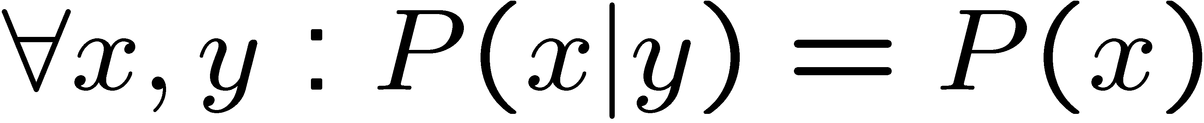
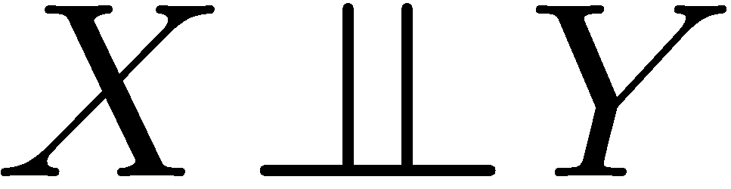
Independence
Two variables are independent if:
This says that their joint distribution factors into a product two simpler distributions
Another form:
We write:
Independence is a simplifying modeling assumption
Empirical joint distributions: at best “close” to independent
What could we assume for {Weather, Traffic, Cavity, Toothache}?
Notes:
How do we know if two variables are independent? We can test it by comparing their joint distribution to their marginal distributions. By the Product Rule we know that P(x,y) = P(y)*P(x|y) (or P(x,y) = P(x)*P(y|x)) However, if they are independent then the distribution is just P(x)*P(y). In addition we could also write For_all x, y : P(y|x) = P(y) We could assume {Weather, Traffic}, {Cavity, Toothache}

Slide 6
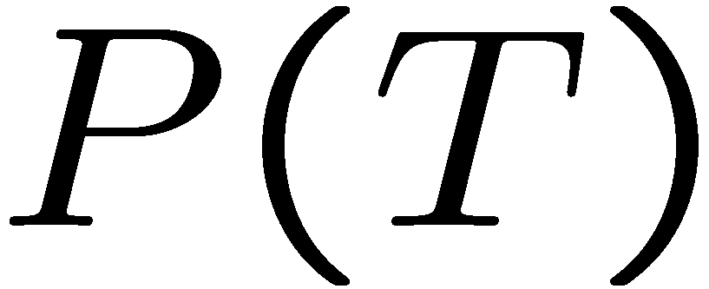
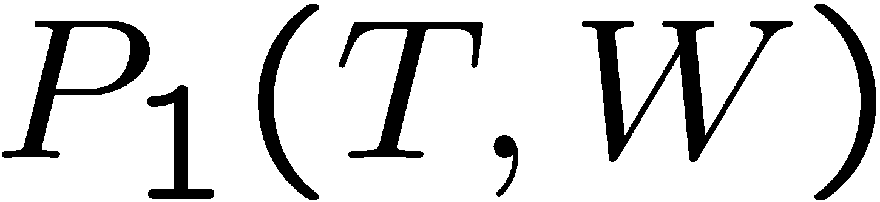
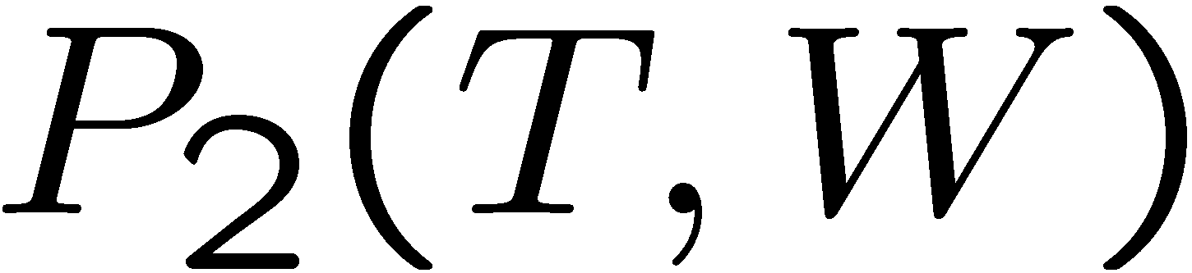
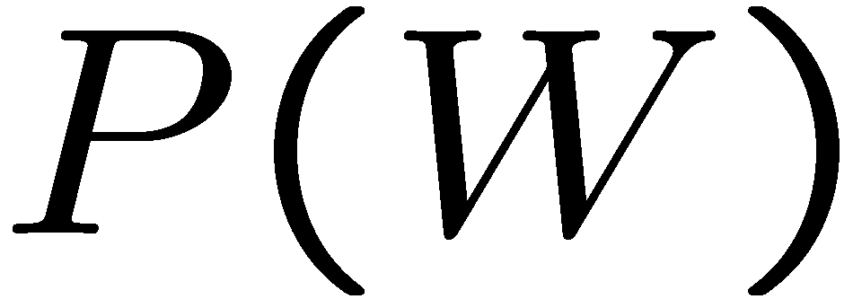
Independence?
T | P
hot | 0.5
cold | 0.5
T | W | P
hot | sun | 0.4
hot | rain | 0.1
cold | sun | 0.2
cold | rain | 0.3
T | W | P
hot | sun | 0.3
hot | rain | 0.2
cold | sun | 0.3
cold | rain | 0.2
W | P
sun | 0.6
rain | 0.4
Notes:
How do can we test if two variables are independent? We can multiply their marginal distributions together P(x)*P(y) and compare it to their joint distribution. If one row is different, then we know that they are not independent.

Slide 7


Independence
N fair, independent coin flips:
P(X₁)
P(X₂)
P(X_{n})
H | 0.5
T | 0.5
H | 0.5
T | 0.5
H | 0.5
T | 0.5
P(X₁, X₂, … X_{n})
2^{n}
Notes:
The joint distribution table has 2^n possible entries. That’s going to be a very large table. But these are independent, so if we just represent them with the marginal, then we have 2*n tables. Full independence is a limiting assumption. Why because if we measure something about 1 variable, we cannot make inferences about any of the other variables. But that inference is exactly what we would like to be able to do. Conditional independence is a weaker assumption, but we can do more with it.

Slide 8
Thank you for voting!!!
Probabilistic Reasoning and Bayes Nets
We had an 80% participation rate in the extra credit assignment.
8 years ago,
only 20% of eligible Penn students voted.
Slides courtesy of Dan Klein and Pieter Abbeel. All of UC Berkeley’s Intro to AI at materials are available at http://ai.berkeley.edu.

Slide 9

Conditional Independence
P(Toothache, Cavity, Detect)
If I have a cavity, the probability that the probe detects it doesn't depend on whether I have a toothache:
P(+detect | +toothache, +cavity) = P(+detect | +cavity)
The same independence holds if I don’t have a cavity:
P(+detect | +toothache, -cavity) = P(+detect| -cavity)
Detect is conditionally independent of Toothache given Cavity:
P(Detect | Toothache, Cavity) = P(Detect | Cavity)
Equivalent statements:
P(Toothache | Detect , Cavity) = P(Toothache | Cavity)
P(Toothache, Detect | Cavity) = P(Toothache | Cavity) P(Detect | Cavity)
One can be derived from the other using the chain rule
Notes:
We can say if I have a cavity then the chance that the probe will detect it is independent of the fact that I have a toothache.
We say that Toothache and Detect are conditionally indpendent given Cavity.

Slide 10
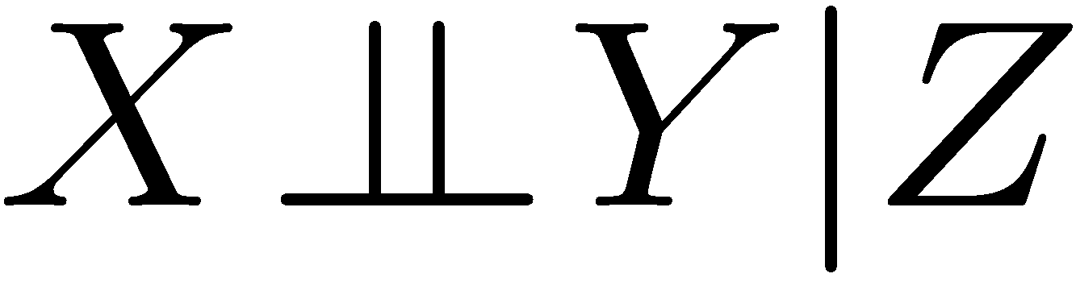
Conditional Independence
Unconditional (absolute) independence very rare, and it doesn’t help us make inferences about other variables.
Conditional independence is our most basic and robust form of knowledge about uncertain environments.
X is conditionally independent of Y given Z
if and only if:
or, equivalently, if and only if
Notes:
How do we prove that? Let’s prove that the first one implies the second.
1) First, let’s start with the definition of the conditional… P(x,z|y) = P(x,y,z) / P(y,z)
2) Let’s re-write the numerator as P(x,y|z)*P(z)* which is just the definition of the joint. Keep the denominator for now.
3) Let’s use our assumption to rewrite the first part of the numerator as (Px|z) * P(y|z) (* P(z)). Then we can re-write the denominator as P(y|z)* P(z), and cancel terms to find that P(X|Z,Y) = P(X|Z).
Also equivalent: For All x,y,z: P(y|z,x) = P(y|z)

Slide 11
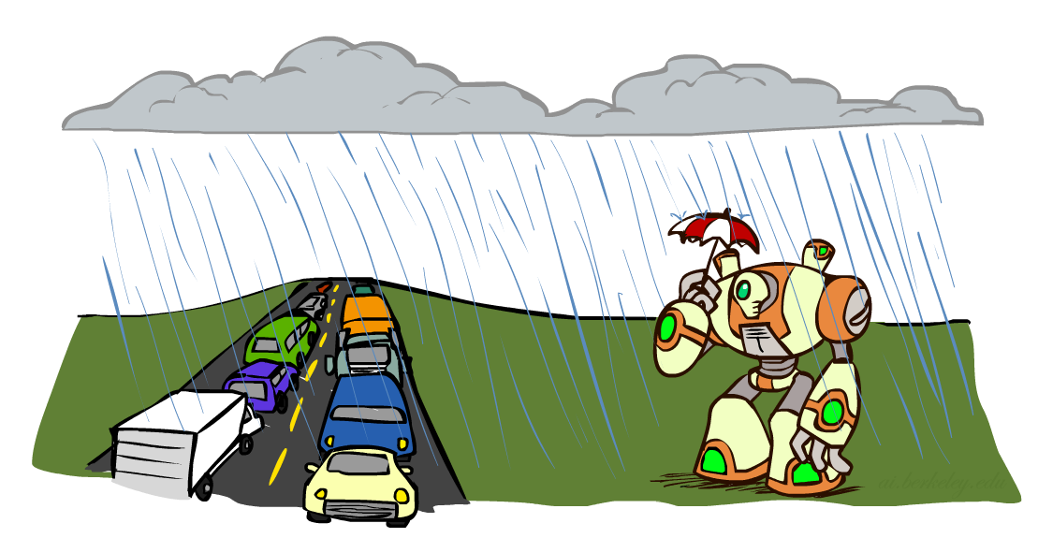
Conditional Independence
What about this domain:
Traffic
Umbrella
Raining
Notes:
What’s a reasonable conditional independence assumption to make here? T _||_ U | R. We can also write U _||_ T | R.

Slide 12
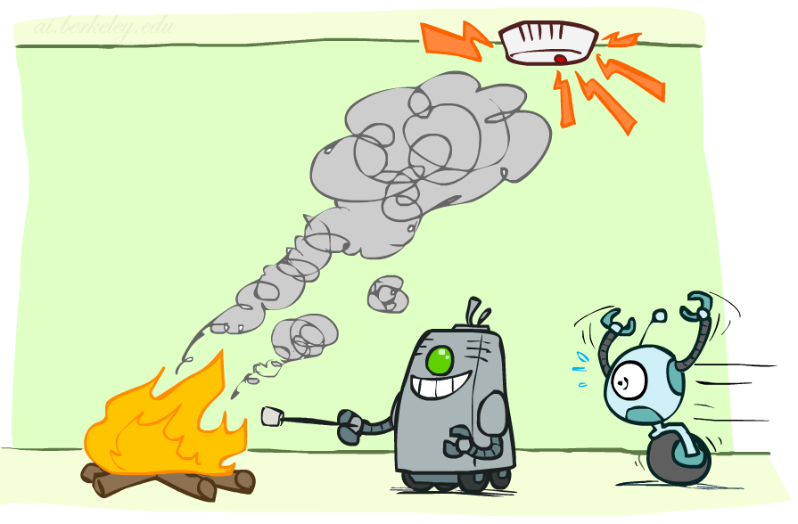
Conditional Independence
What about this domain:
Fire
Smoke
Alarm
Notes:
What’s a reasonable conditional independence assumption to make here? A _||_ F | S. Alarm just triggers on smoke (not heat or anything).

Slide 13

Conditional Independence and the Chain Rule
Chain rule:
Trivial decomposition:
With assumption of conditional independence:
Bayes’nets / graphical models help us express conditional independence assumptions
Notes:
Conditional Independence is going to be key in everything we do, via the chain rules. We pick an ordering of variables. There are N! ways of doing this ordering.
Let’s look at the chain rule for Traffic, Rain, Umbrella. This is with no Independence assumptions whatsoever. This is always true. But if we’re willing to assume that traffic and umbrellas are independent given rain (T_||_U | R) then we can cross out the given traffic.
Why is this interesting? The size of the distributions are very different.
If you have y|x1…xk? If we have binary variables, then we have 2^k rows in your distribution (or maybe 2^k*2, depending on how you’re writing the tables).
Also it gives us a way of trying to encode our beliefs about causal processes.

Slide 14
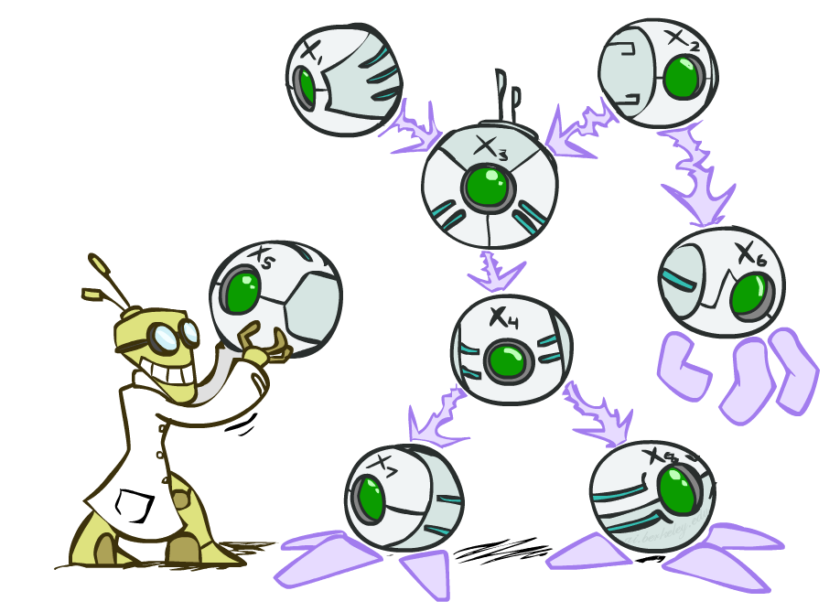
Bayes’ Nets: Big Picture
Two problems with using full joint distribution tables as our probabilistic models:
Unless there are only a few variables, the joint is WAY too big to represent explicitly
Hard to learn (estimate) anything empirically about more than a few variables at a time
Bayes’ nets: a technique for describing complex joint distributions (models) using simple, local distributions (conditional probabilities)
More properly called graphical models
We describe how variables locally interact
Local interactions chain together to give global, indirect interactions
Notes:
Bayes Nets give us a different way of thinking about probability distributions. Instead of just a full joint table, we’re going to go to a more compact representation that directly encodes our independence assumptions and which give us a graphical way of representing the interaction of variables which makes the structure of the problem much more obvious.

Slide 15
Bayes’ Nets
Examples and Notation
Slides courtesy of Dan Klein and Pieter Abbeel. All of UC Berkeley’s Intro to AI at materials are available at http://ai.berkeley.edu.

Slide 16
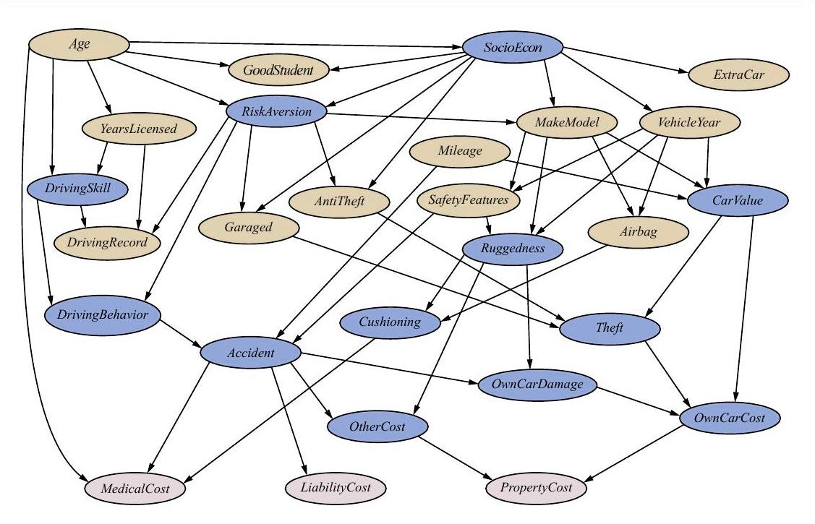
Example Bayes’ Net: Insurance
Notes:
Let’s build some intuition.
27 variables in the insurance domain. If they are binary then there are 2^27 which is approx. 134 million entries. So it’s not going to be plausible to enumerate.
Let’s take a look at this structure. There’s an arrow from socioeconomic status to extra car. So whether you have an extra car in your household depends on your socio economic status.
What about anit-theft?
Blue + Lavender = unobserved. (Lavender – claims to be paid out.)
Yellow = observed.

Slide 17
Example Bayes’ Net: Car
Notes:
Here’s a trouble shooting model.
Thing at the bottom are the effect, things at the top are causes. 2^16 = approx 65k for the full joint instantiation. Here we only care about the local interaction?
Where’s the most work in this? Car wont start. 2^k for the k conditioning variables. In this case 2^5=32.

Slide 18
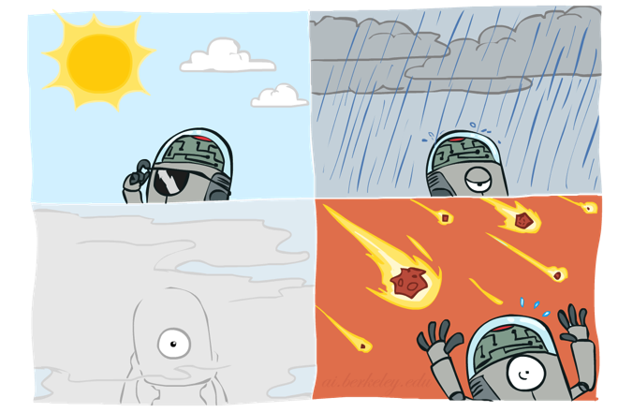
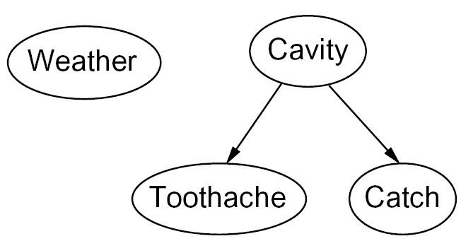
Graphical Model Notation
Nodes: variables (with domains)
Can be assigned (observed) or unassigned (unobserved)
Arcs: interactions
Indicate “direct influence” between variables
Formally: encode conditional independence (more later)
For now: imagine that arrows mean direct causation (in general, they don’t!)
Notes:
If an arc is missing, we are assuming that it is conditionally independent of the ones that it’s missing the arcs to. Intuitively we are encoding the direct interactions between variables.
We only condition on a node’s parents.
Here’s a BN for the cavity example.

Slide 19
Example: Coin Flips
N independent coin flips
No interactions between variables: absolute independence
X₁
X₂
X_{n}
Notes:
What does the BN look like for this? No edges at all!!!

Slide 20
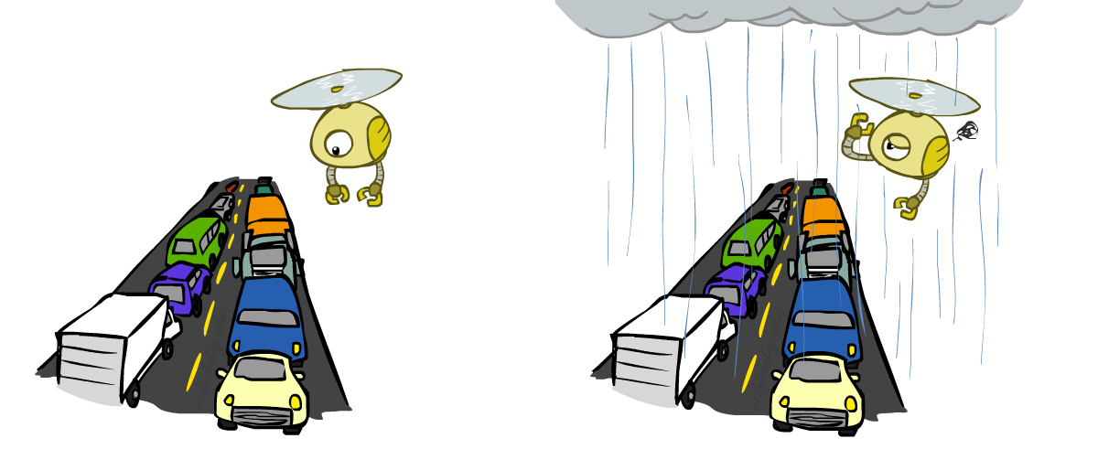
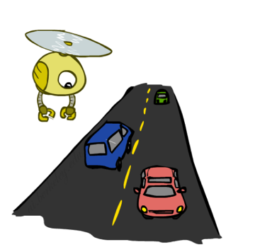
Example: Traffic
Variables:
R: It rains
T: There is traffic
Model 1: independence
Why is an agent using model 2 better?
Model 2: rain causes traffic
R
R
T
T
Notes:
How about the traffic domain?
Both of these will specify full joint distributions. In one you just need to specify two marginal distributions, in the other, you need to specify the P(T|R) and the P(R) distributions.

Slide 21
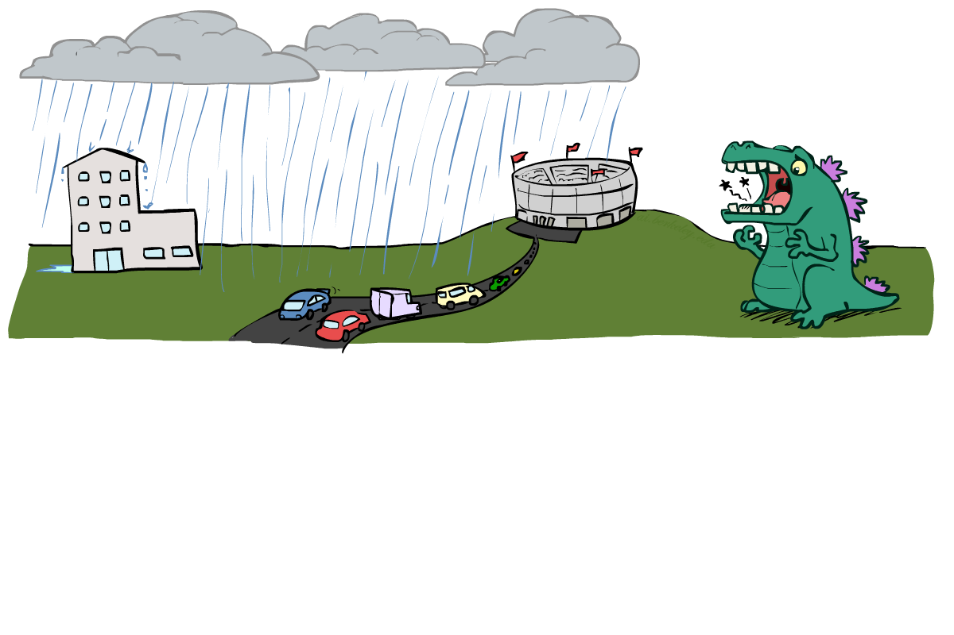
Example: Traffic II
Let’s build a causal graphical model!
Variables
T: Traffic
R: It rains
L: Low pressure
D: Roof drips
B: Ballgame
C: Cavity
Notes:
T
R → T
L → R
R → D
B → T
R → B
C

Slide 22
Example: Traffic II
Let’s build a causal graphical model!
Variables
T: Traffic
R: It rains
L: Low pressure
D: Roof drips
B: Ballgame
C: Cavity
L
R
C
B
D
T

Slide 23
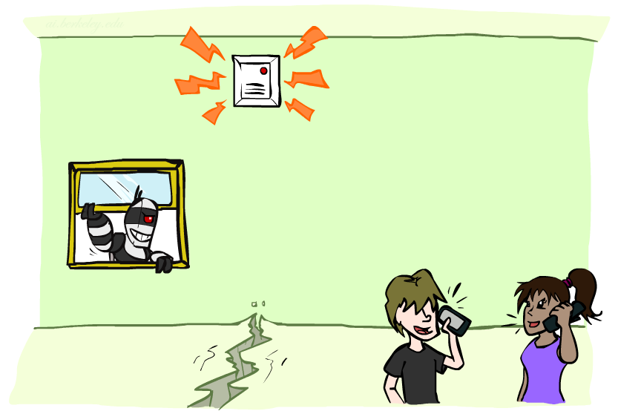
Example: Alarm Network
Variables
B: Burglary
A: Alarm goes off
M: Mary calls
J: John calls
E: Earthquake!
Notes:
B
B -> A
A -> M
A -> J
E -> A

Slide 24
Example: Alarm Network
Variables
B: Burglary
A: Alarm goes off
M: Mary calls
J: John calls
E: Earthquake!
B
E
A
M
J

Slide 25
HW9, HW10 due dates has been postponed. HW9 is now due 12/4 (after Thanksgiving). HW10 is now due 12/11 (final day of classes).
Bayes’ Nets
Probabilities
OH are canceled from Monday Nov 20 through Sunday Nov 26 for Thanksgiving break. Limited OH Dec 8-10.
Slides courtesy of Dan Klein and Pieter Abbeel. All of UC Berkeley’s Intro to AI at materials are available at http://ai.berkeley.edu.

Slide 26
Example: Traffic II
Let’s build a causal graphical model!
Variables
T: Traffic
R: It rains
L: Low pressure
D: Roof drips
B: Ballgame
C: Cavity
L
R
C
B
D
T

Slide 27
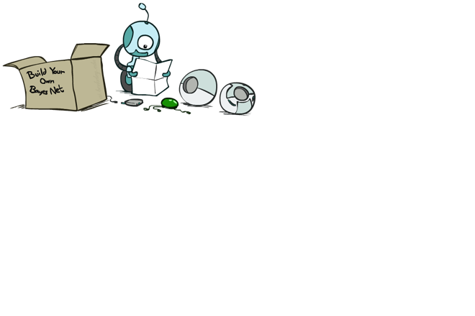
Bayes’ Net Semantics
A set of nodes, one per variable X
A directed, acyclic graph
A conditional distribution for each node
A collection of distributions over X, one for each combination of parents’ values
CPT: conditional probability table
Description of a noisy “causal” process
A₁
A_{n}
X
P(X | a₁ … a_{n})
P(X | A₁ … A_{n})
A Bayes net = Topology (graph) + Local Conditional Probabilities
Notes:
CCB - here

Slide 28
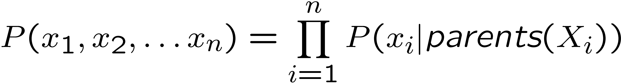

Probabilities in BNs
Bayes’ nets implicitly encode joint distributions
As a product of local conditional distributions
To see what probability a BN gives to a full assignment, multiply all the relevant conditionals together:
Example:
P(+cavity, +detect, -toothache)
Notes:
I’m going to make a CLAIM now. You can get a full joint distribution as the product of the conditionals.
We look at the variables, starting with cavity, since it has not parents. So P(+cav, +catch, -toothache) = P(+cavity) * P(+catch|+cavity) * P(-toothache|+cavity).
So far that’s just a claim. Let’s show that it is true.

Slide 29
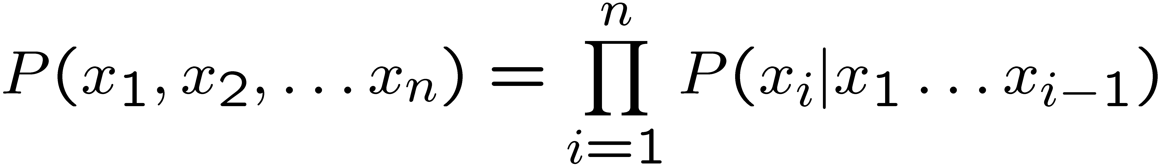
Probabilities in BNs
Why are we guaranteed that setting
results in a proper joint distribution?
Chain rule (valid for all distributions):
Assume conditional independences:
→ Consequence:
Not every BN can represent every joint distribution
The topology enforces certain conditional independencies
Notes:
All entries will be positive. Will they sum to one? Here’s the conditional independence assumptions that we’re making.
Xi _||_ {xi…Xi-q} – Parents(Xi) | Parents(Xi)
For X _||_ Y | Z
for all x,y,z: P(x | z, y) = P(x| z)

Slide 30
Example: Coin Flips
X₁
X₂
X_{n}
P(X₁)
P(X₂)
P(X_{n})
h | 0.5
t | 0.5
h | 0.5
t | 0.5
h | 0.5
t | 0.5
P(h,h, t, h) =
Only distributions whose variables are absolutely independent can be represented by a Bayes’ net with no arcs.
Notes:
0.5 * 0.5 * 0.5 * 0.5 = 0.0625

Slide 31

Example: Traffic
P(R)
R
+r | 1/4
-r | 3/4
P(+r, -t) =
P(T|R)
+r | +t | 3/4
 | -t | 1/4
T
-r | +t | 1/2
 | -t | 1/2
Notes:
p(x1, x2) = Product_{i=1}^N p(x_i | parents(x_i))
P(+r) * P(-t|+r) = ¼ * ¼ = 1/16.

Slide 32

Bayes’ Nets
So far: how a Bayes’ net encodes a joint distribution
Today: how to answer queries about that distribution
Main goal: answer queries about conditional independence and influence
Finally: how to answer numerical queries (inference)

Slide 33

Example: Alarm Network
B | P(B)
+b | 0.001
-b | 0.999
E | P(E)
+e | 0.002
-e | 0.998
Burglary
Earthquake
Alarm
B | E | A | P(A|B,E)
+b | +e | +a | 0.95
+b | +e | -a | 0.05
+b | -e | +a | 0.94
+b | -e | -a | 0.06
-b | +e | +a | 0.29
-b | +e | -a | 0.71
-b | -e | +a | 0.001
-b | -e | -a | 0.999
John calls
Mary calls
A | J | P(J|A)
+a | +j | 0.9
+a | -j | 0.1
-a | +j | 0.05
-a | -j | 0.95
A | M | P(M|A)
+a | +m | 0.7
+a | -m | 0.3
-a | +m | 0.01
-a | -m | 0.99
Notes:
Let’s think through what probability tables we would need for our alarm network. For each variable we need to construct a local condition probability table of that variable, given its parents. WRITE OUT PROBABILITIES ABOVE EACH VARIABLE
Here’s the Full BN including the tables. Should we be surprised that the alarm table is the biggest? No, that’s just the consequence of its having the most parents.
What if we wanted the probability of this? P(+b, -e +a, +j, +m)? We just select all rows that are consistent with it, and then we get the probability.
B E A J M,
E_||_B
J_||_B,E,M|A
M_||_ B,E,J|A.
These are the things that get left out of our linearization of the chain rule.

Slide 34

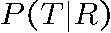
Example: Traffic
Causal direction
R
+r | 1/4
-r | 3/4
+r | +t | 3/16
+r | -t | 1/16
-r | +t | 6/16
-r | -t | 6/16
+r | +t | 3/4
 | -t | 1/4
T
-r | +t | 1/2
 | -t | 1/2
Notes:
Causality is not a mathematical necessity. You can use it in your BN, but you don’t have to. Mathematically it doesn’t play a role. Look at the joint prob. 3, 1, 6, 6.

Slide 35
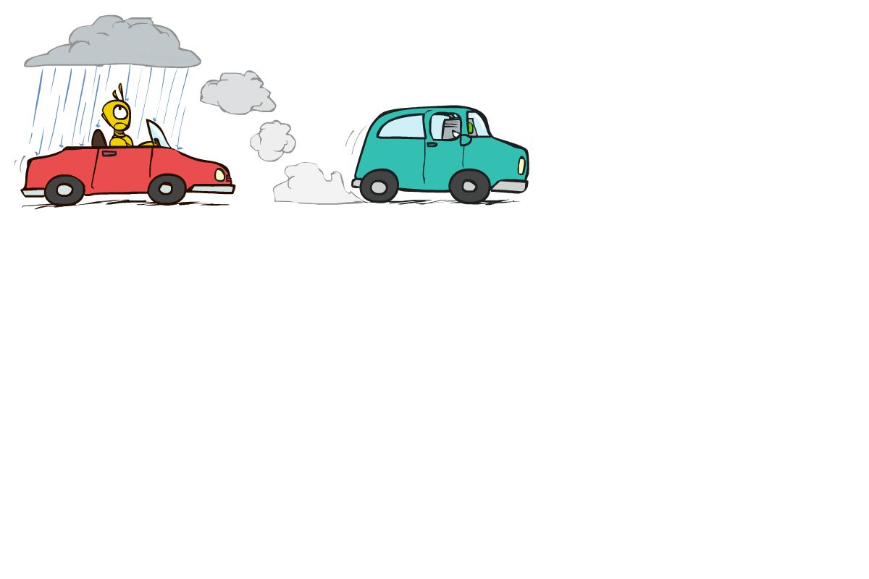
Example: Reverse Traffic
Reverse causality?
P(T)
T
+t | 9/16
-t | 7/16
P(R, T)
P(R|T)
+r | +t | 3/16
+r | -t | 1/16
-r | +t | 6/16
-r | -t | 6/16
+t | +r | 1/3
 | -r | 2/3
R
-t | +r | 1/7
 | -r | 6/7
Notes:
Here? Specified by a different graph and a different set of tables, but we can still encode the same joint distribution as we had before: 3, 1, 6, 6.

Slide 36
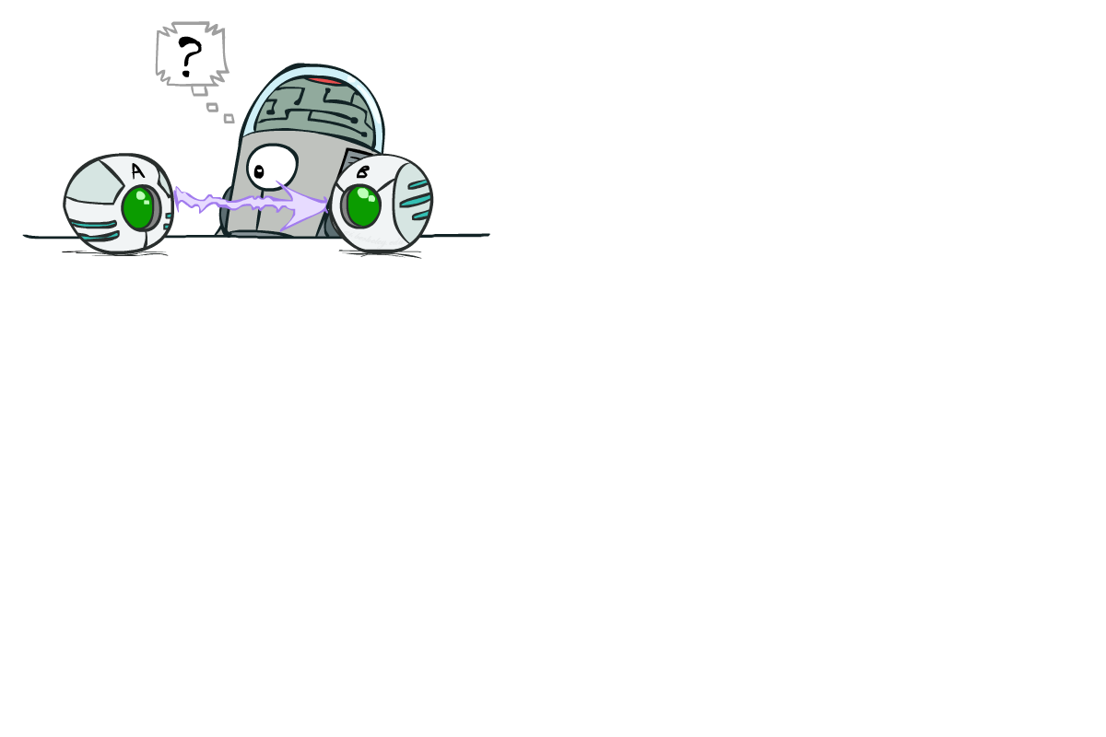
Causality?
When Bayes’ nets reflect the true causal patterns:
Often simpler (nodes have fewer parents)
Often easier to think about
Often easier to elicit from experts
BNs need not actually be causal
Sometimes no causal net exists over the domain (especially if variables are missing)
E.g. consider the variables Traffic and Drips
End up with arrows that reflect correlation, not causation
What do the arrows really mean?
Topology may happen to encode causal structure
Topology really encodes conditional independence
Notes:
BNs don’t have to be causal. Often times we do choose them to be causal, since it often uses fewer parents. It’s also easier to think about and to elicit from experts.
For non-causal ones, consider traffic and drips. In a casual BN we have R -> T and R-> D, but we could equally well have T->D (or vice versa) if that were an easier table to generate. That would reflect a correlation, not a causation.
So what do the arrows represent?

Slide 37
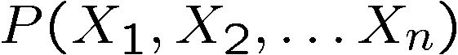
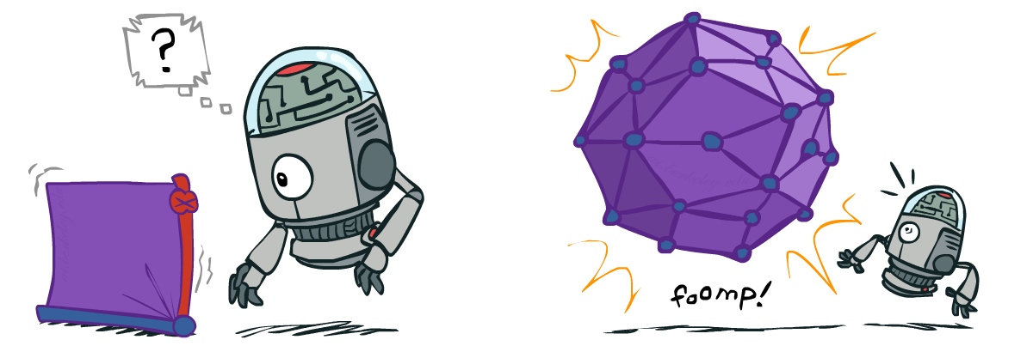
Size of a Bayes’ Net
How big is a joint distribution over N Boolean variables?
2^{N}
How big is an N-node net if nodes have up to k parents?
O(N * 2^{k+1})
Both give you the power to calculate
BNs: Huge space savings!
Also easier to elicit local CPTs
Also faster to answer queries (coming)
Notes:
Linear in N rather than exponential in N

Slide 38
Size of a Bayes’ Net
How big is a joint distribution over N Boolean variables?
2^{N}
How big is an N-node net if nodes have up to k parents?
O(N * 2^{k+1})
Both give you the power to calculate
BNs: Huge space savings!
Also easier to elicit local CPTs
Also faster to answer queries (coming)
Notes:
Linear in N rather than exponential in N

Slide 39
Bayes’ Nets
Properties
Slides courtesy of Dan Klein and Pieter Abbeel. All of UC Berkeley’s Intro to AI at materials are available at http://ai.berkeley.edu.

Slide 40


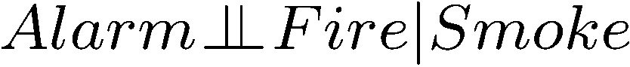
Conditional Independence
X and Y are independent if
X and Y are conditionally independent given Z
(Conditional) independence is a property of a distribution
Example:

Slide 41
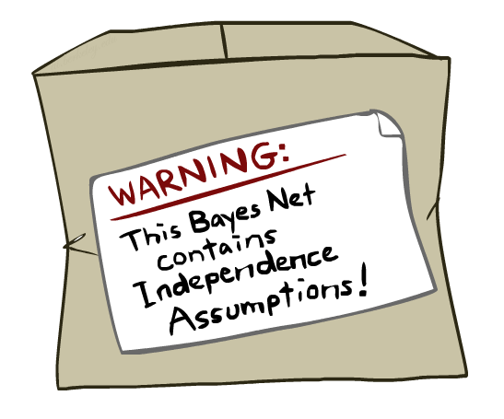
Bayes Nets: Assumptions
Assumptions we are required to make to define the Bayes net when given the graph:
Beyond above “chain rule → Bayes net” conditional independence assumptions
Often additional conditional independences
They can be read off the graph
Important for modeling: understand assumptions made when choosing a Bayes net graph
Notes:
We encode some conditional independencies explicitly.
However, there are almost always some additional conditional independence assumptions that are present. And they can be read off the graph.

Slide 42
Chair Rule Simplifications
X
Y
Z
W
Assumptions we are required to make to define the Bayes Net when given the graph:
Conditional independence assumptions directly from simplifications in chain rule:

Slide 43
Chair Rule Simplifications
X
Y
Z
W
Assumptions we are required to make to define the Bayes Net when given the graph:
Conditional independence assumptions directly from simplifications in chain rule: From the chain rule: P(X,Y,Z,W) = P(X) P(Y|X) P(Z|X,Y) P(W|X,Y,Z) From the Bayes Net: P(X,Y,Z,W) = P(X) P(Y|X) P(Z|Y) P(W|Z) Z _||_X|Y W _||_X,Y|Z p(Z|X,Y) = P(Z|Y) p(W|X,Y,Z = P(W|Z)
Notes:
We go from P(X,Y,Z,W) = P(X) P(Y|X) P(Z|X,Y) P(W|X,Y,Z) via the chain rule to P(X) P(Y|X) P(Z|Y) P(W|Z)
So Z_||_X|Y, W_||_X,Y|Z. Any other that are true given this Bayes Net? (Z is independent of X given Y).

Slide 44
Probabilistic Reasoning and Bayes Nets
Slides courtesy of Dan Klein and Pieter Abbeel. All of UC Berkeley’s Intro to AI at materials are available at http://ai.berkeley.edu.

Slide 45
Independence in a BN
Important question about a BN:
Are two nodes independent given certain evidence?
If yes, can prove using algebra (sometimes tedious)
If no, can prove with a counter example
Example:
Question: are X and Z necessarily independent?
Answer: no. Example: low pressure causes rain, which causes traffic.
X can influence Z, Z can influence X (via Y)
Addendum: they could be independent: how?
X
Y
Z
Notes:
Addendum: Uniform given the parent values. This just means that the parents are irrelevant. This means that by just looking at the graph structure we can’t always infer that they’re not independent.

Slide 46
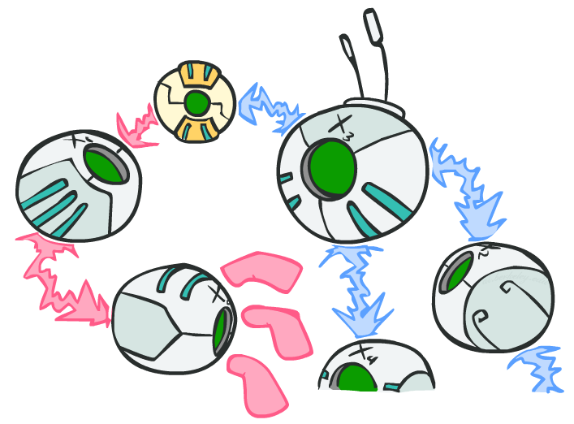
D-separation: Outline
Notes:
Study independence properties for triples
Analyze complex cases in terms of member triples
D-separation: a condition / algorithm for answering such queries
D is for Descendants.

Slide 47
D-separation: Outline
Study independence properties for triples
Analyze complex cases in terms of member triples
D-separation: a condition / algorithm for answering such queries

Slide 48
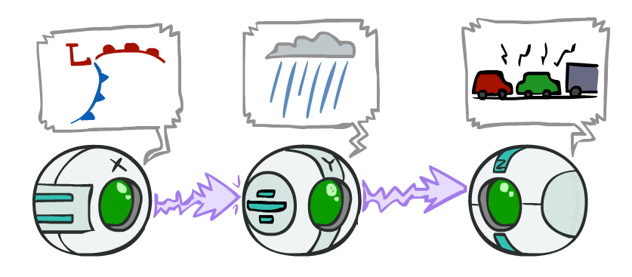
Causal Chains
This configuration is a “causal chain”
Guaranteed X independent of Z ? No!
One example set of CPTs for which X is not independent of Z is sufficient to show this independence is not guaranteed.
Example:
Low pressure causes rain causes traffic,
high pressure causes no rain causes no
traffic
In numbers:
P( +y | +x ) = 1, P( -y | - x ) = 1,
P( +z | +y ) = 1, P( -z | -y ) = 1
X: Low pressure Y: Rain Z: Traffic
Notes:
Write the bayesnet in the upper right corner. Ask X _||_ Z
If we know X then we also know Z.

Slide 49
Causal Chains
This configuration is a “causal chain”
Guaranteed X independent of Z given Y?
X: Low pressure Y: Rain Z: Traffic
Notes:
The assumptions that are available to us are given by P(X,Y,X) = P(X) P(Y|X) P(Z|Y)
X _||_Z | Y
Z _||_ X | Y
p(z | x, y ) = p(z|y)
Can we show that this will always be true given this Bayes Net?

Slide 50
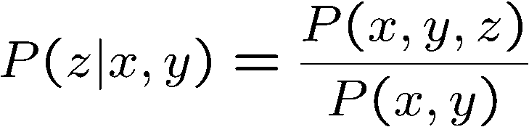
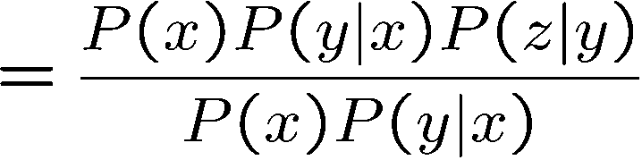
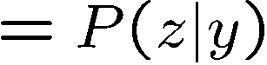
Causal Chains
This configuration is a “causal chain”
Guaranteed X independent of Z given Y?
Evidence along the chain “blocks” the influence
X: Low pressure Y: Rain Z: Traffic
Yes!
Notes:
The assumptions that are available to us are given by P(X,Y,X) = P(X) P(Y|X) P(Z|Y)

Slide 51
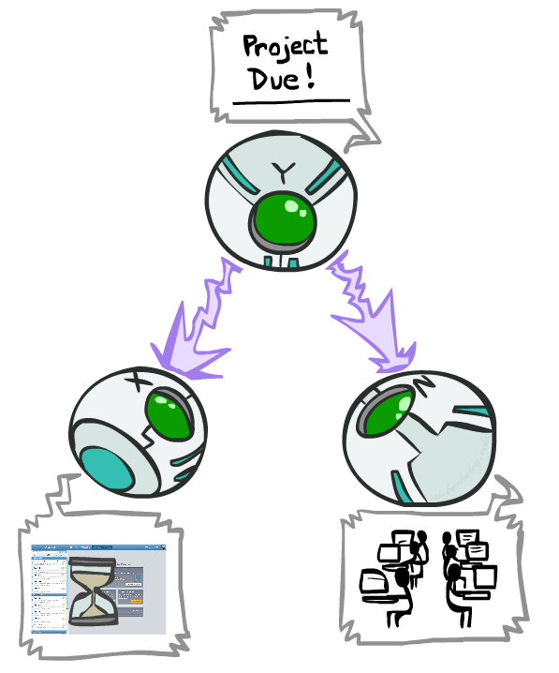
Common Cause
This configuration is a “common cause”
Guaranteed X independent of Z ? No!
One example set of CPTs for which X is not independent of Z is sufficient to show this independence is not guaranteed.
Example:
Project due causes both forums busy
and office hours full
In numbers:
P( +x | +y ) = 1, P( -x | -y ) = 1,
P( +z | +y ) = 1, P( -z | -y ) = 1
Y: Project due
X: Forums busy
Z: Office hours full
Notes:
Write the bayesnet in the upper right corner. Ask X _||_ Z
If we know X then we also know Z.
Deterministic.

Slide 52
Common Cause
This configuration is a “common cause”
Guaranteed X and Z independent given Y?
Y: Project due
X: Forums busy
Z: Office hours full
Notes:
X_||_Z | Y ?
is p(z|x,y) = p(z|y) ?
Substitute the Bayesnet into the numerator, cancel terms.

Slide 53
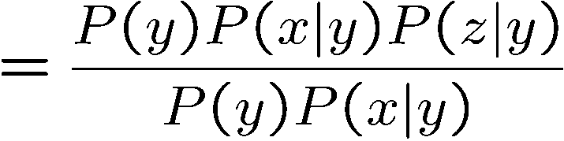
Common Cause
This configuration is a “common cause”
Guaranteed X and Z independent given Y?
Observing the cause blocks influence between effects.
Y: Project due
X: Forums busy
Z: Office hours full
Yes!

Slide 54
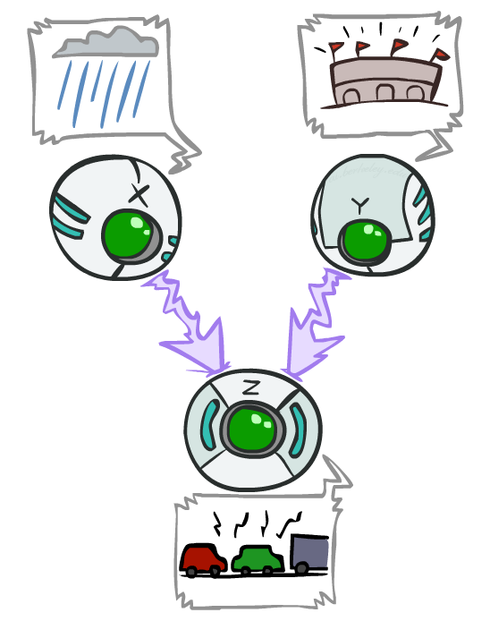
Common Effect
Last configuration: two causes of one effect (v-structures)
Are X and Y independent?
Yes: the ballgame and the rain cause traffic, but they are not correlated
Still need to prove they must be (try it!)
Are X and Y independent given Z?
No: seeing traffic puts the rain and the ballgame in competition as explanation.
This is backwards from the other cases
Observing an effect activates influence between possible causes.
X: Raining
Y: Ballgame
Z: Traffic
Notes:
Draw the BayesNet. Write X_||_Y for the first question. Write X_||_Y|Z
Special case where observing the thing in the middle make things depend on each other. One of the causes must be true. Seeing one explains away the need for the other.
P(X,Y,Z) = P(X)P(Y)P(Z|X,Y)
Sum_z P(P(X,Y,Z) = Sum_z P(X)P(Y)P(Z|X,Y)
Move P(X) P(Y) out front, since there’s no Z in there.
= P(X)P(Y) Sum_z P(Z|X,Y). … the sum will add to 1.

Slide 55
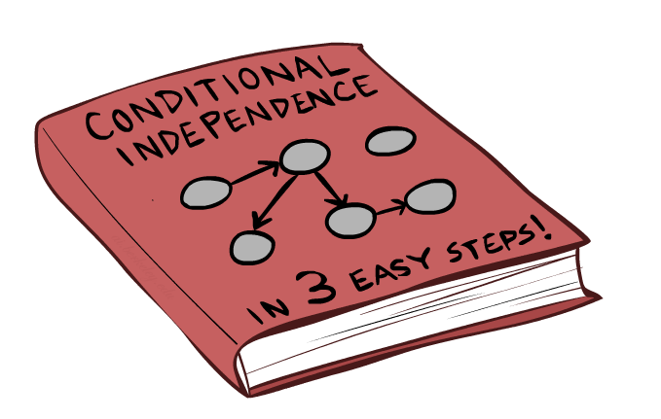
The General Case

Slide 56
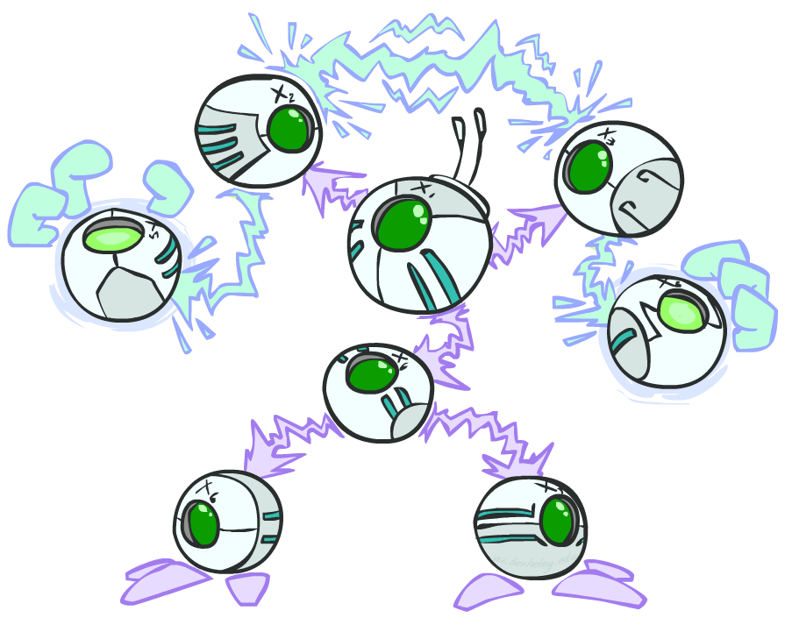
The General Case
General question: in a given BN, are two variables independent (given evidence)?
Solution: analyze the graph
Any complex example can be broken
into repetitions of the three canonical cases
Notes:
Here

Slide 57

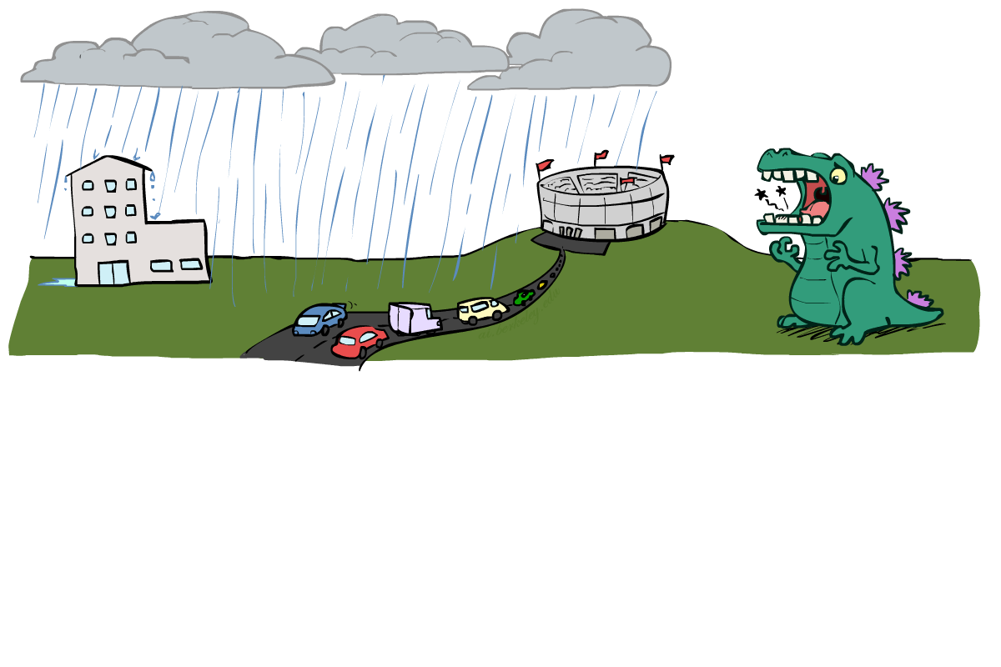
Reachability
L
Recipe: shade evidence nodes, look for paths in the resulting graph
Attempt 1: if two nodes are connected by an undirected path not blocked by a observed (shaded) node, they are conditionally independent
Almost works, but not quite
Where does it break?
Answer: the v-structure at T doesn’t count as a link in a path unless “active”
R
B
D
T

Slide 58
Active / Inactive Paths
Question: Are X and Y conditionally independent given evidence variables {Z}?
Yes, if X and Y “d-separated” by Z
Consider all (undirected) paths from X to Y
No active paths = independence!
A path is active if each triple is active:
Causal chain A → B → C where B is unobserved (either direction)
Common cause A ← B → C where B is unobserved
Common effect (aka v-structure)
A → B ← C where B or one of its descendents is observed
All it takes to block a path is a single inactive segment
Active Triples
Inactive Triples
Notes:
Gray is observed.
CCB: Draw the active triples and inactive triples on the board. They are useful for figuring out the examples later.

Slide 59
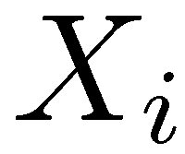
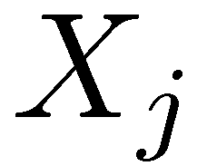

D-Separation
?
Query:
Check all (undirected!) paths between and
If one or more active, then independence not guaranteed
Otherwise (i.e. if all paths are inactive),
then independence is guaranteed
Notes:
All triples on ones of the paths are active, then there is no guarantee of independent.

Slide 60

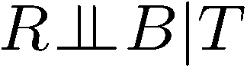
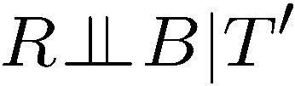
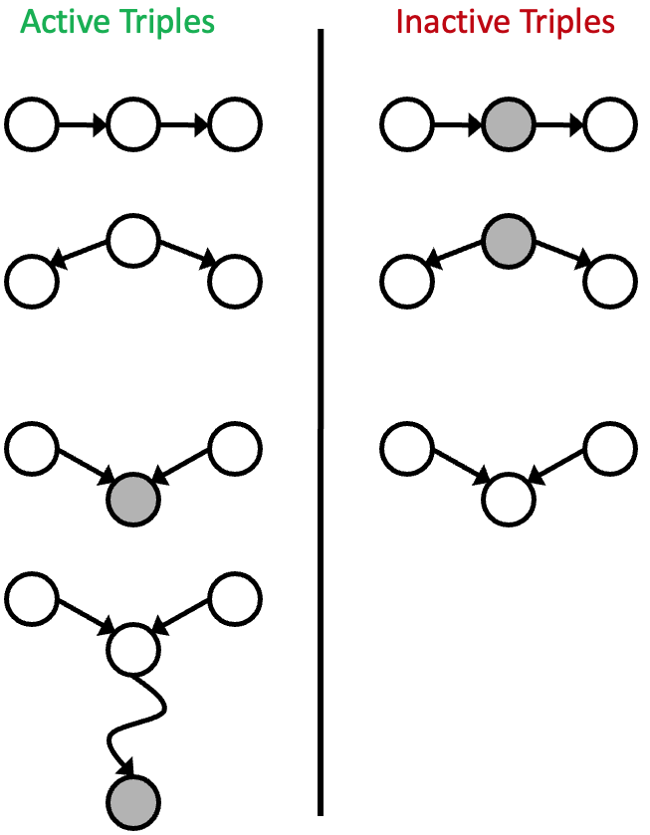
Example
Yes
R
B
T
T’
If one or more paths is active, then independence not guaranteed
if all paths are inactive then independence is guaranteed
A path is active if each triple is active
Notes:
T’: traffic report
For two and 3, the entire path is active, so no guarantee

Slide 61
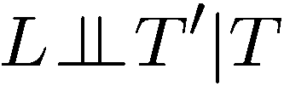

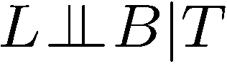
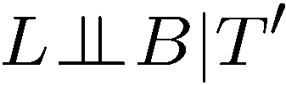
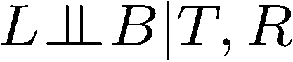
Example
L
Yes
R
B
Yes
D
T
Yes
T’
If one or more paths is active, then independence not guaranteed
if all paths are inactive then independence is guaranteed
A path is active if each triple is active
Notes:
. if all paths are inactive),
then independence is guaranteed

Slide 62
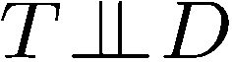
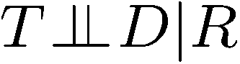
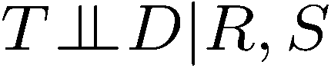
Example
Variables:
R: Raining
T: Traffic
D: Roof drips
S: I’m sad
Questions:
R
T
D
S
Yes

Slide 63

Structure Implications
Given a Bayes net structure, can run d-separation algorithm to build a complete list of conditional independences that are necessarily true of the form
This list determines the set of probability distributions that can be represented

Slide 64

Computing All Independences
Y
X
Z
Y
X
Z
X
Z
Y
Y
X
Z

Slide 65
Topology Limits Distributions
Given some graph topology G, only certain joint distributions can be encoded
The graph structure guarantees certain (conditional) independences
(There might be more independence)
Adding arcs increases the set of distributions, but has several costs
Full conditioning can encode any distribution
Y
Y
X
Z
X
Z
Y
X
Z
Y
X
Z
Y
Y
Y
X
Z
X
Z
X
Z
Y
Y
Y
X
Z
X
Z
X
Z

Slide 66
Bayes Nets Representation Summary
Bayes nets compactly encode joint distributions
Guaranteed independencies of distributions can be deduced from BN graph structure
D-separation gives precise conditional independence guarantees from graph alone
A Bayes’ Net’s joint distribution may have further (conditional) independence that is not detectable until you inspect its specific distribution

Slide 67
Bayes Nets – wrap up
Slides courtesy of Dan Klein and Pieter Abbeel. All of UC Berkeley’s Intro to AI at materials are available at http://ai.berkeley.edu.

Slide 68

Inference
Inference: calculating some useful quantity from a joint probability distribution
Examples:
Posterior probability
Most likely explanation:
Notes:
Answer some useful query about a probability distribution.
Two use cases.
1. Determine the posterior probability of some query given some evidence.
2. Pick the most likely instantiation of the query variable given that evidence.
We’ll focus on the first one, but the second can be answered in a very similar way. You’ll change summations with maxes.

Slide 69











Inference by Enumeration
* Works fine with multiple query variables, too
General case:
Evidence variables:
Query* variable:
Hidden variables:
We want:
All variables
Step 1: Select the entries consistent with the evidence
Step 2: Sum out H to get joint of Query and evidence
Step 3: Normalize
Notes:
Inference by enumeration is something that we looked at before.
Evidence, query and hidden variables.
Hidden variables will be summed out. Then you’ve got the joint between the query and the evidence variables. That’s not what we want, so we normalize over the query variable.

Slide 70
Inference by Enumeration in Bayes’ Net
Given unlimited time, inference in BNs is easy
Reminder of inference by enumeration by example:
B
E
A
J
M
+
Notes:
Query: Distribution for Burglary given +j and +m
Step 1: The conditional is proportional to the joint between these variables. We’ll re-scale by the sum of the entires.
Step 2: Sum over the hidden variables.
Step 3: Definition of the joint distribution given the Bayes Net.
Finally, spell out the sum.
B is capital because that’s still a variable. We’re building a table for it.
What’s wrong with this? We have a nice compact rep with the BN. But we then build this full joint in the sum. This gets very expensive. It’s exponential in the number of non-evidence variables.

Slide 71
+
B | P(B)
+b | 0.001
-b | 0.999
E | P(E)
+e | 0.002
-e | 0.998
P(+b,+m,+j) =
Burglary
Earthquake
0.001*0.002*0.96*0.9*0.7
+ 0.001*0.002*0.05*0.05*0.01 + 0.001*0.998*0.29*0.9*0.7 + 0.001*0.998*0.06*0.05*0.01 = 0.00018357419
Alarm
B | E | A | P(A|B,E)
+b | +e | +a | 0.95
+b | +e | -a | 0.05
+b | -e | +a | 0.94
+b | -e | -a | 0.06
-b | +e | +a | 0.29
-b | +e | -a | 0.71
-b | -e | +a | 0.001
-b | -e | -a | 0.999
P(-b,+m,+j) =
John calls
Mary calls
0.999*0.002*0.29*0.9*0.7
+ 0.999*0.002*0.71*0.05*0.01 + 0.999*0.998*0.001*0.9*0.7 + 0.999*0.998*0.999*0.05*0.01 = 0.00149185764
A | J | P(J|A)
+a | +j | 0.9
+a | -j | 0.1
-a | +j | 0.05
-a | -j | 0.95
A | M | P(M|A)
+a | +m | 0.7
+a | -m | 0.3
-a | +m | 0.01
-a | -m | 0.99
P(+b | +m,+j) = 0.11
P(-b | +m,+j) = 0.89

Slide 72
Inference by Enumeration?
P(Accident | observed variables) = ?
Notes:
What’s wrong with this? We have a nice compact rep with the BN. But we then build this full joint in the sum. This gets very expensive. It’s exponential in the number of non-evidence variables.
Blue + Lavender = unobserved. (Lavender – claims to be paid out.)
Yellow = observed. 12 of those, so 2^12 items to compute. 2^12 = 4,096 Too big for a simple query like this.

Slide 73
Inference by Enumeration vs. Variable Elimination
Why is inference by enumeration so slow?
You join up the whole joint distribution before you sum out the hidden variables
Advanced technique: Variable Elimination
Interleave joining and marginalizing
Still NP-hard, but usually much faster than inference by enumeration
See the textbook for a description.
First we’ll need some new notation: factors

Slide 74
Next time: Naïve Bayes
Read AIMA Section 19.1
Slides courtesy of Dan Klein and Pieter Abbeel --- University of California, Berkeley
[These slides were created by Dan Klein and Pieter Abbeel for CS188 Intro to AI at UC Berkeley. All CS188 materials are available at http://ai.berkeley.edu.]
Notes:
Please retain proper attribution, including the reference to ai.berkeley.edu. Thanks!

